Slide 1
STAT 497
APPLIED TIME SERIES ANALYSIS
INTRODUCTION

Slide 2
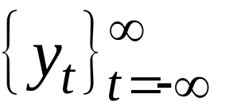
DEFINITION
A stochastic process is a collection of random variables or a process that develops in time according to probabilistic laws.
The theory of stochastic processes gives us a formal way to look at time series variables.

Slide 3

DEFINITION
For a fixed t, Y(w, t) is a random variable
For a given w, Y(w, t) is called a sample function or a realization as a function of t.
belongs to sample space
Indexed set

Slide 4
DEFINITION
Time series is a realization or sample function from a certain stochastic process.
A time series is a set of observations generated sequentially in time. Therefore, they are dependent to each other. This means that we do NOT have random sample.
We assume that observations are equally spaced in time.
We also assume that closer observations might have stronger dependency.

Slide 5
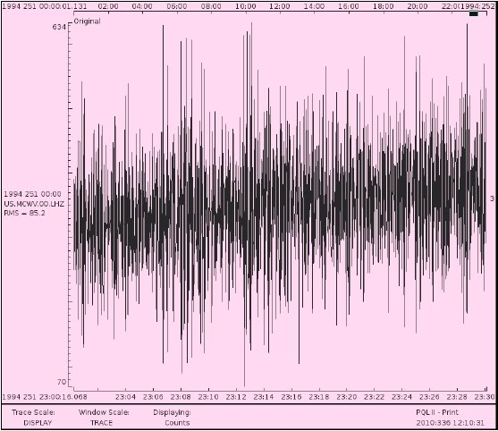
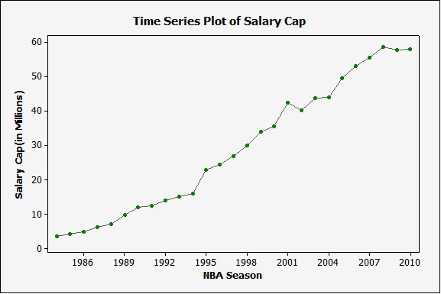
DEFINITION
Discrete time series is one in which the set T₀ at which observations are made is a discrete set. Continuous time series are obtained when observations are recorded continuously over some time interval.

Slide 6
EXAMPLES
Data in business, economics, engineering, environment, medicine, earth sciences, and other areas of scientific investigations are often collected in the form of time series.
Hourly temperature readings
Daily stock prices
Weekly traffic volume
Annual growth rate
Seasonal ice cream consumption
Electrical signals

Slide 7
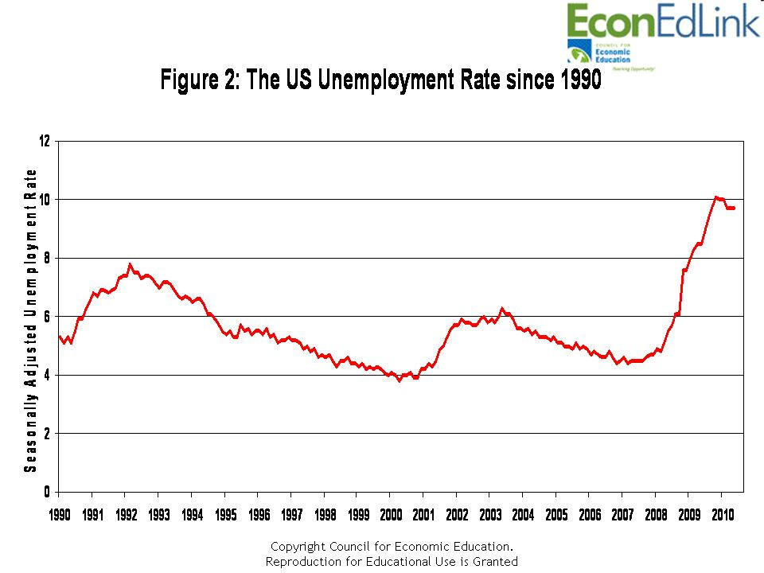
EXAMPLES

Slide 8
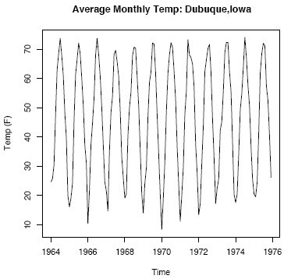
EXAMPLES

Slide 9
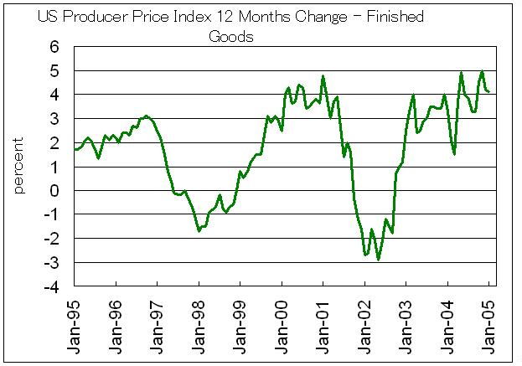
EXAMPLES

Slide 10
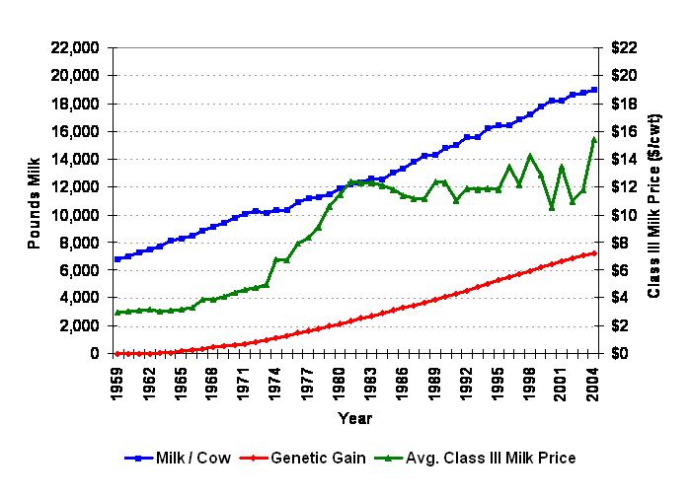
EXAMPLES

Slide 11
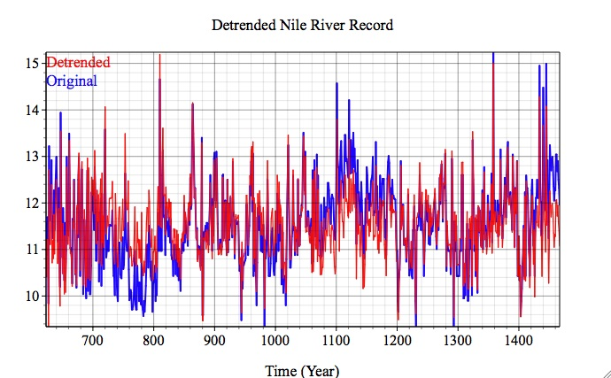
EXAMPLES

Slide 12
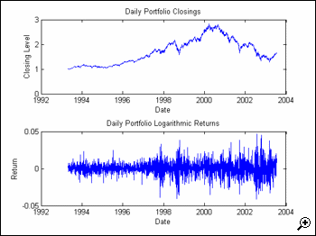
EXAMPLES

Slide 13
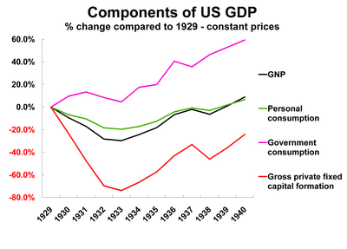
EXAMPLES

Slide 14
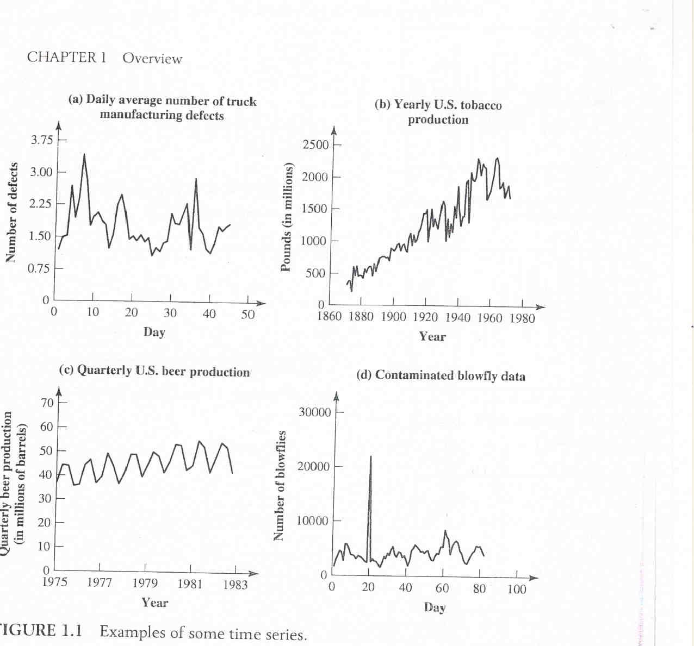
EXAMPLES

Slide 15
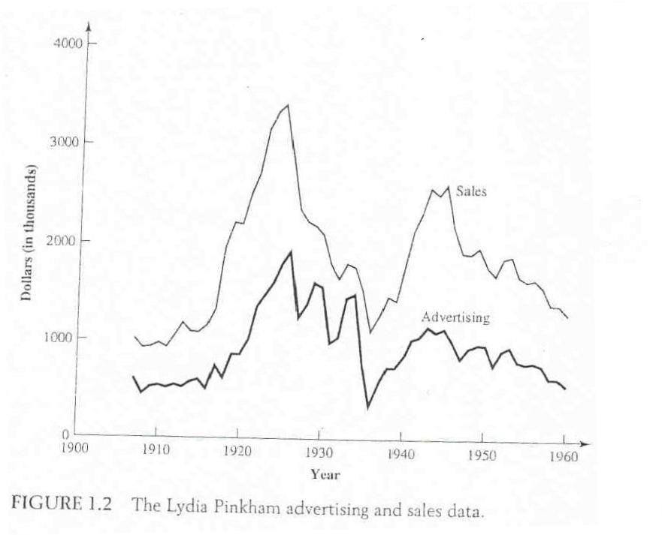
EXAMPLES

Slide 16
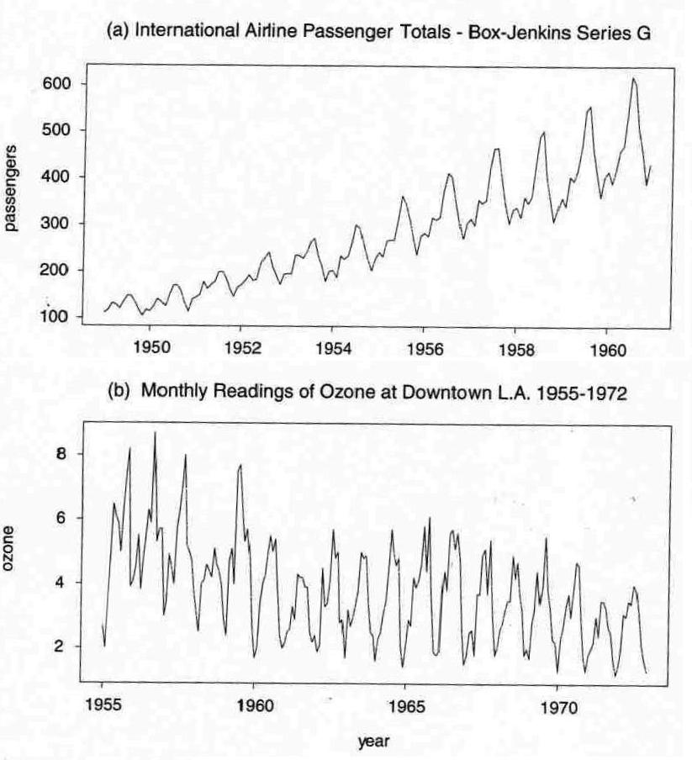
EXAMPLES

Slide 17
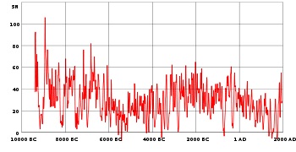
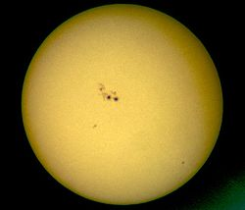
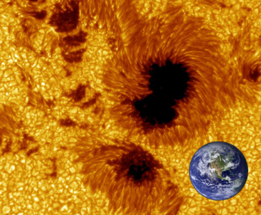
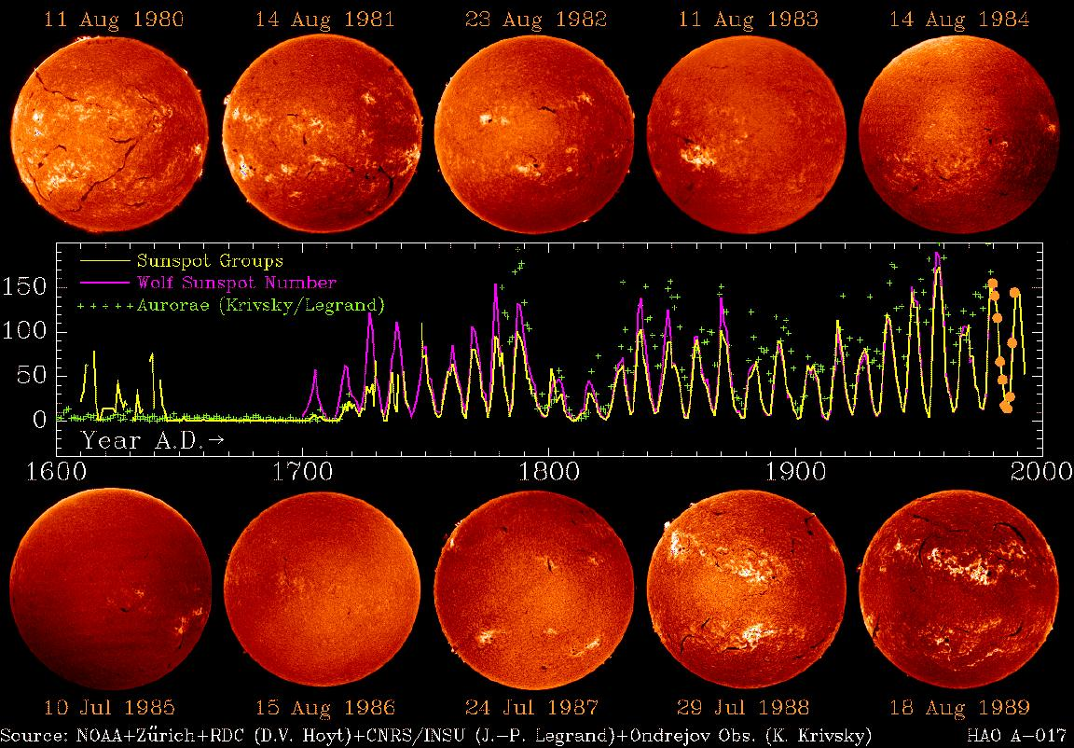
EXAMPLES (SUNSPOT NUMBERS)

Slide 18
OBJECTIVES OF TIME SERIES ANALYSIS
Understanding the dynamic or time-dependent structure of the observations of a single series (univariate analysis)
Forecasting of future observations
Ascertaining the leading, lagging and feedback relationships among several series (multivariate analysis)

Slide 19
STEPS IN TIME SERIES ANALYSIS
Model Identification
  Time Series plot of the series
  Check for the existence of a trend or seasonality
  Check for the sharp changes in behavior
  Check for possible outliers
Remove the trend and the seasonal component to get stationary residuals.
Estimation
  MME
  MLE
Diagnostic Checking
  Normality of error terms
  Independency of error terms
  Constant error variance (Homoscedasticity)
Forecasting
  Exponential smoothing methods
  Minimum MSE forecasting

Slide 20
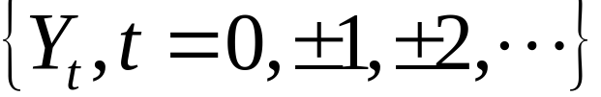
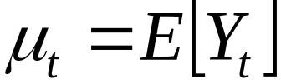
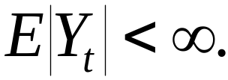
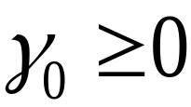
CHARACTERISTICS OF A SERIES
For a time series
THE MEAN FUNCTION:
THE VARIANCE FUNCTION:
Exists iff
The expected value of the process at time t.

Slide 21
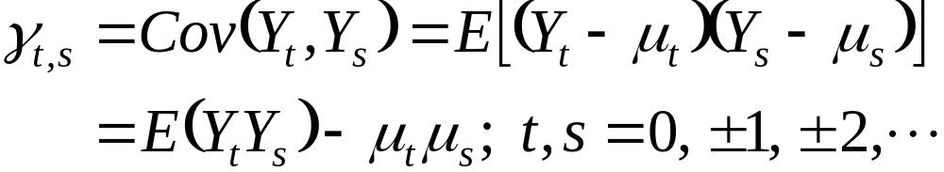
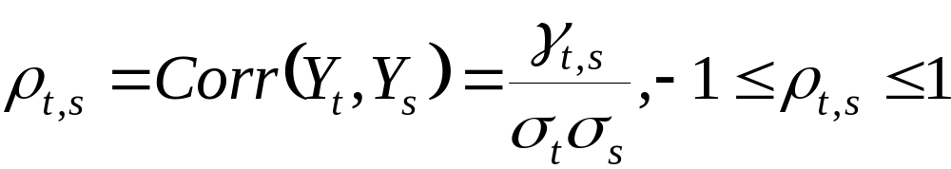
CHARACTERISTICS OF A SERIES
THE AUTOCOVARIANCE FUNCTION:
THE AUTOCORRELATION FUNCTION:
Covariance between the value at time t and the value at time s of a stochastic process Y_{t}.
The correlation of the series with itself

Slide 22
EXAMPLE
Moving average process: Let ε_{t}∼i.i.d.(0, 1), and
X_{t} = ε_{t} + 0.5 ε_{t−1}

Slide 23

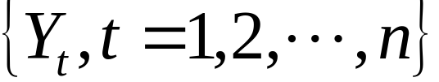
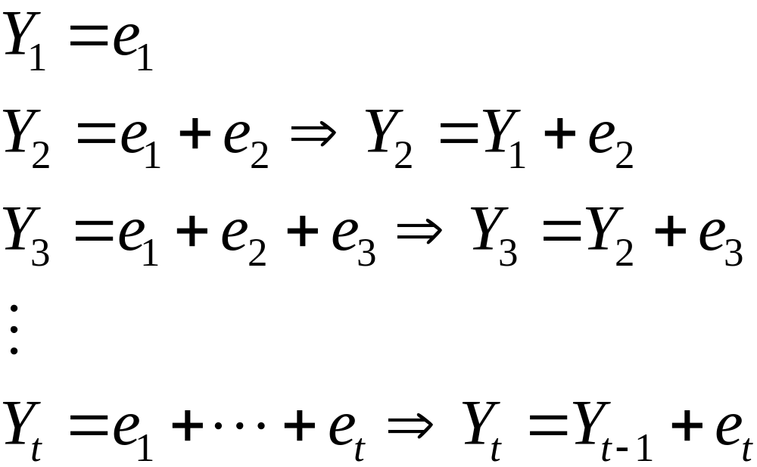
EXAMPLE
RANDOM WALK: Let e₁,e₂,… be a sequence of i.i.d. rvs with 0 mean and variance . The observed time series
is obtained as

Slide 24
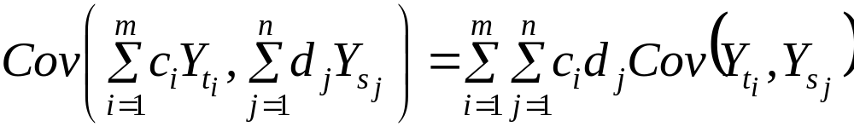
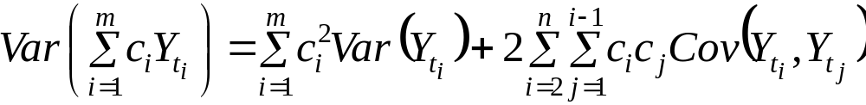
A RULE ON THE COVARIANCE
If c₁, c₂,…, c_{m} and d₁, d₂,…, d_{n} are constants and t₁, t₂,…, t_{m} and s₁, s₂,…, s_{n} are time points, then

Slide 25
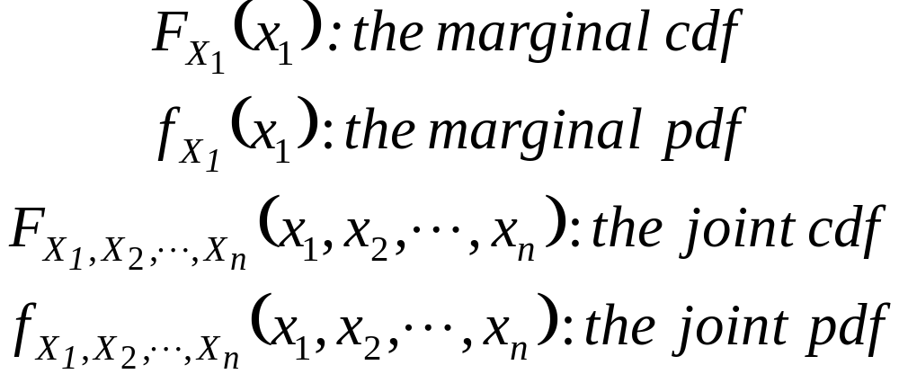
JOINT PDF OF A TIME SERIES
Remember that

Slide 26
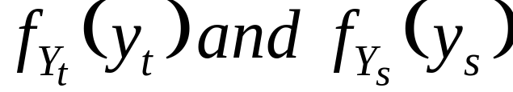
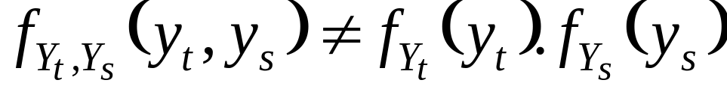
JOINT PDF OF A TIME SERIES
For the observed time series, say we have two points, t and s.
The marginal pdfs:
The joint pdf:

Slide 27
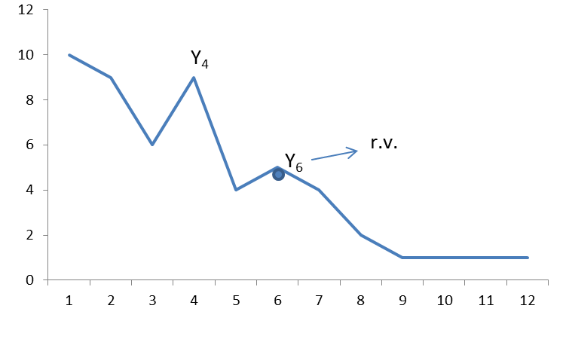
JOINT PDF OF A TIME SERIES
Since we have only one observation for each r.v. Y_{t}, inference is too complicated if distributions (or moments) change for all t (i.e. change over time). So, we need a simplification.
r.v.

Slide 28
JOINT PDF OF A TIME SERIES
To be able to identify the structure of the series, we need the joint pdf of Y₁, Y₂,…, Y_{n}. However, we have only one sample. That is, one observation from each random variable. Therefore, it is very difficult to identify the joint distribution. Hence, we need an assumption to simplify our problem. This simplifying assumption is known as STATIONARITY.

Slide 29
STATIONARITY
The most vital and common assumption in time series analysis.
The basic idea of stationarity is that the probability laws governing the process do not change with time.
The process is in statistical equilibrium.

Slide 30
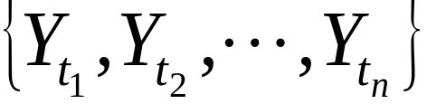

TYPES OF STATIONARITY
STRICT (STRONG OR COMPLETE) STATIONARY PROCESS: Consider a finite set of r.v.s.
from a stochastic process
The n-dimensional distribution function is defined by
where y_{i}, i=1, 2,…, n are any real numbers.

Slide 31
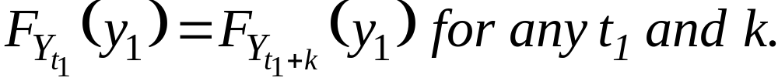
STRONG STATIONARITY
A process is said to be first order stationary in distribution, if its one dimensional distribution function is time-invariant, i.e.,
Second order stationary in distribution if
n-th order stationary in distribution if

Slide 32
STRONG STATIONARITY
n-th order stationarity in distribution = strong stationarity
→ Shifting the time origin by an amount “k” has no effect on the joint distribution, which must therefore depend only on time intervals between t₁, t₂,…, t_{n}, not on absolute time, t.

Slide 33
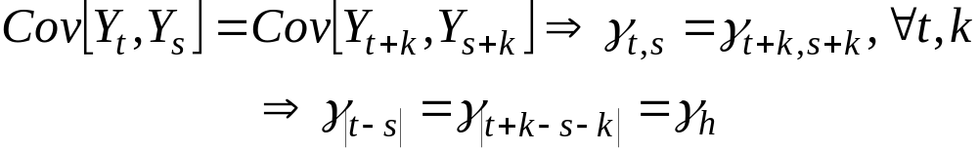
STRONG STATIONARITY
So, for a strong stationary process
i)
ii)
iii)
iv)
Expected value of a series is constant over time, not a function of time
The variance of a series is constant over time, homoscedastic.
Not constant, not depend on time, depends on time interval, which we call “lag”, k

Slide 34
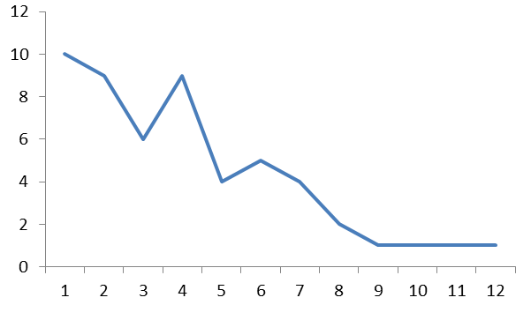
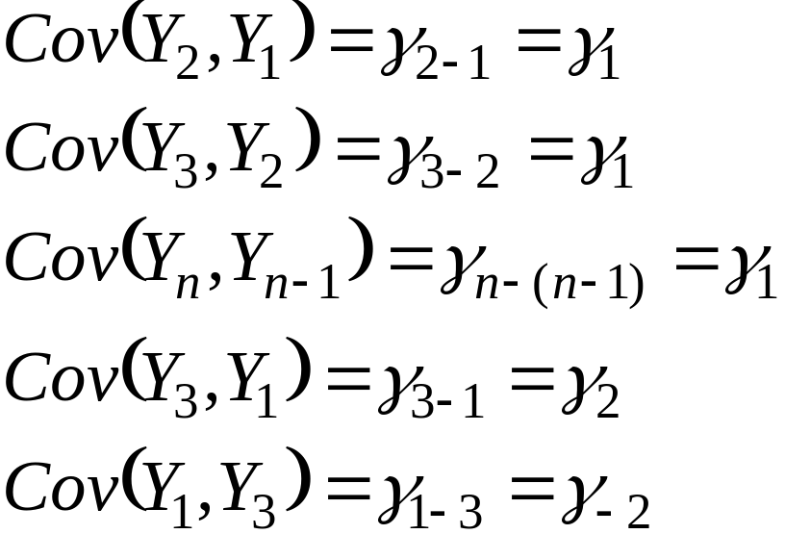
STRONG STATIONARITY
Y_{t}
Y₁
Y₂
Y₃
………………………………………....
Y_{n}
μ
μ
μ
μ
σ²
σ²
σ²
σ²
t
Affected from time lag, k

Slide 35
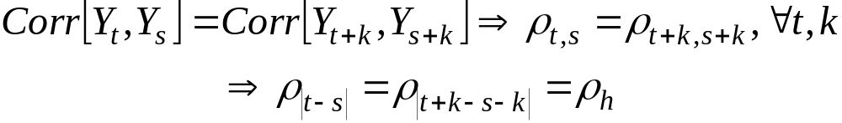

STRONG STATIONARITY
v)
Let t=t-k and s=t,
It is usually impossible to verify a distribution particularly a joint distribution function from an observed time series. So, we use weaker sense of stationarity.

Slide 36
WEAK STATIONARITY
WEAK (COVARIANCE) STATIONARITY OR STATIONARITY IN WIDE SENSE: A time series is said to be covariance stationary if its first and second order moments are unaffected by a change of time origin.
That is, we have constant mean and variance with covariance and correlation beings functions of the time difference only.

Slide 37
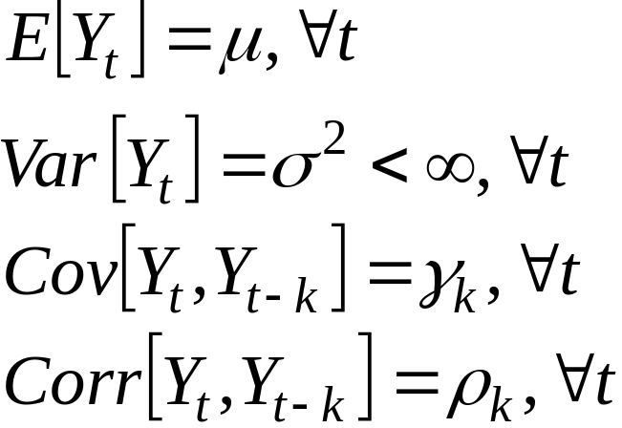
WEAK STATIONARITY
From, now on, when we say “stationary”, we imply weak stationarity.

Slide 38
EXAMPLE
Consider a time series {Y_{t}} where
Y_{t}=e_{t}
and e_{t}∼i.i.d.(0,σ²). Is the process stationary?

Slide 39
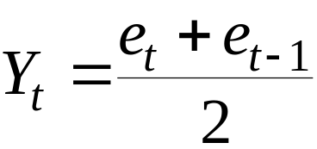
EXAMPLE
MOVING AVERAGE: Suppose that {Y_{t}} is constructed as
and e_{t}∼i.i.d.(0,σ²). Is the process {Y_{t}} stationary?

Slide 40

EXAMPLE
RANDOM WALK
where e_{t}∼i.i.d.(0,σ²). Is the process {Y_{t}} stationary?

Slide 41

EXAMPLE
Suppose that time series has the form
where a and b are constants and {e_{t}} is a weakly stationary process with mean 0 and autocovariance function γ_{k}. Is {Y_{t}} stationary?

Slide 42
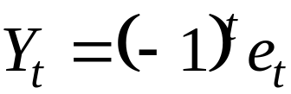
EXAMPLE
where e_{t}∼i.i.d.(0,σ²). Is the process {Y_{t}} stationary?

Slide 43
STRONG VERSUS WEAK STATIONARITY
Strict stationarity means that the joint distribution only depends on the ‘difference’ h, not the time (t₁, . . . , t_{k}).
Finite variance is not assumed in the definition of strong stationarity, therefore, strict stationarity does not necessarily imply weak stationarity. For example, processes like i.i.d. Cauchy is strictly stationary but not weak stationary.
A nonlinear function of a strict stationary variable is still strictly stationary, but this is not true for weak stationary. For example, the square of a covariance stationary process may not have finite variance.
Weak stationarity usually does not imply strict stationarity as higher moments of the process may depend on time t.

Slide 44
STRONG VERSUS WEAK STATIONARITY
If process {X_{t}} is a Gaussian time series, which means that the distribution functions of {X_{t}} are all multivariate Normal, weak stationary also implies strict stationary. This is because a multivariate Normal distribution is fully characterized by its first two moments.

Slide 45
STRONG VERSUS WEAK STATIONARITY
For example, a white noise is stationary but may not be strict stationary, but a Gaussian white noise is strict stationary. Also, general white noise only implies uncorrelation while Gaussian white noise also implies independence. Because if a process is Gaussian, uncorrelation implies independence. Therefore, a Gaussian white noise is just i.i.d. N(0, σ²).

Slide 46
STATIONARITY AND NONSTATIONARITY
Stationary and nonstationary processes are very different in their properties, and they require different inference procedures. We will discuss this in detail through this course.

